Slide 1
Large Language Models
Introduction to Large Language Models

Slide 2
Language models
Remember the simple n-gram language model
Assigns probabilities to sequences of words
Generate text by sampling possible next words
Is trained on counts computed from lots of text
Large language models are similar and different:
Assigns probabilities to sequences of words
Generate text by sampling possible next words
Are trained by learning to guess the next word

Slide 3
Large language models
Even through pretrained only to predict words
Learn a lot of useful language knowledge
Since training on a lot of text

Slide 4
Three architectures for large language models
Decoders Encoders Encoder-decoders
GPT, Claude, BERT family, Flan-T5, Whisper
Llama HuBERT
Mixtral

Slide 5
Encoders
Many varieties!
Popular: Masked Language Models (MLMs)
BERT family
Trained by predicting words from surrounding words on both sides
Are usually finetuned (trained on supervised data) for classification tasks.

Slide 6
Encoder-Decoders
Trained to map from one sequence to another
Very popular for:
machine translation (map from one language to another)
speech recognition (map from acoustics to words)

Slide 7
Large Language Models
Large Language Models: What tasks can they do?

Slide 8
Big idea
Many tasks can be turned into tasks of predicting words!

Slide 9
This lecture: decoder-only models
Also called:
Causal LLMs
Autoregressive LLMs
Left-to-right LLMs
Predict words left to right

Slide 10
Conditional Generation: Generating text conditioned on previous text
Notes:
In predicting each next word, the model can see a representation of all the previous words

Slide 11
Many practical NLP tasks can be cast as word prediction!
Sentiment analysis: “I like Jackie Chan”
We give the language model this string: The sentiment of the sentence "I like Jackie Chan" is:
And see what word it thinks comes next:

Slide 12
Framing lots of tasks as conditional generation
QA: “Who wrote The Origin of Species”
We give the language model this string:
And see what word it thinks comes next:
And iterate:

Slide 13
Summarization
Original
Summary

Slide 14
LLMs for summarization (using tl;dr)

Slide 15
Large Language Models
Sampling for LLM Generation

Slide 16
Decoding and Sampling
This task of choosing a word to generate based on the model’s probabilities is called decoding.
The most common method for decoding in LLMs: sampling.
Sampling from a model’s distribution over words:
choose random words according to their probability assigned by the model.
After each token we’ll sample words to generate according to their probability conditioned on our previous choices,
A transformer language model will give the probability

Slide 17
Random sampling

Slide 18
Random sampling doesn't work very well
Even though random sampling mostly generate sensible, high-probable words,
There are many odd, low- probability words in the tail of the distribution
Each one is low- probability but added up they constitute a large portion of the distribution
So they get picked enough to generate weird sentences

Slide 19
Factors in word sampling: quality and diversity
Emphasize high-probability words
+ quality: more accurate, coherent, and factual,
- diversity: boring, repetitive.
Emphasize middle-probability words
+ diversity: more creative, diverse,
- quality: less factual, incoherent

Slide 20
Top-k sampling:
Choose # of words k
For each word in the vocabulary V , use the language model to compute the likelihood of this word given the context p(wt |w_{<t} )
Sort the words by likelihood, keep only the top k most probable words.
Renormalize the scores of the k words to be a legitimate probability distribution.
Randomly sample a word from within these remaining k most-probable words according to its probability.
Notes:
When k = 1, top-k sampling is identical to greedy decoding.
Setting k to a larger number than 1 leads us to sometimes select a word which is not necessarily the most probable, but is still probable enough, and whose choice results in generating more diverse but still high-enough-quality text.

Slide 21
Top-p sampling (= nucleus sampling)
Holtzman et al., 2020
Problem with top-k: k is fixed so may cover very different amounts of probability mass in different situations
Idea: Instead, keep the top p percent of the probability mass
Given a distribution P(w_{t} |w_{<t} ), the top-p vocabulary V ( p) is the smallest set of words such that
Notes:
sometimes the top k words will be very likely and include most of the probability mass, but other times flatter and the top 10 words will only include a small part of the probability mass.

Slide 22
Temperature sampling
Reshape the distribution instead of truncating it
Intuition from thermodynamics,
a system at high temperature is flexible and can explore many possible states,
a system at lower temperature is likely to explore a subset of lower energy (better) states.
In low-temperature sampling, (τ ≤ 1) we smoothly
increase the probability of the most probable words
decrease the probability of the rare words.

Slide 23
Temperature sampling
Divide the logit by a temperature parameter τ before passing it through the softmax.
Instead of
We do

Slide 24
Temperature sampling
0 ≤ τ ≤ 1
Why does this work?
When τ is close to 1 the distribution doesn’t change much.
The lower τ is, the larger the scores being passed to the softmax
Softmax pushes high values toward 1 and low values toward 0.
Large inputs pushes high-probability words higher and low probability word lower, making the distribution more greedy.
As τ approaches 0, the probability of most likely word approaches 1
Notes:
(dividing by a smaller fraction τ ≤ 1 results in making each score larger).

Slide 25
Large Language Models
Pretraining Large Language Models: Algorithm

Slide 26
Pretraining
The big idea that underlies all the amazing performance of language models
First pretrain a transformer model on enormous amounts of text
Then apply it to new tasks.

Slide 27
Self-supervised training algorithm
We just train them to predict the next word!
Take a corpus of text
At each time step t
ask the model to predict the next word
train the model using gradient descent to minimize the error in this prediction
"Self-supervised" because it just uses the next word as the label!

Slide 28
Intuition of language model training: loss
Same loss function: cross-entropy loss
We want the model to assign a high probability to true word w
= want loss to be high if the model assigns too low a probability to w
CE Loss: The negative log probability that the model assigns to the true next word w
If the model assigns too low a probability to w
We move the model weights in the direction that assigns a higher probability to w

Slide 29
Cross-entropy loss for language modeling
CE loss: difference between the correct probability distribution and the predicted distribution
The correct distribution y_{t} knows the next word, so is 1 for the actual next word and 0 for the others.
So in this sum, all terms get multiplied by zero except one: the logp the model assigns to the correct next word, so:

Slide 30
Teacher forcing
At each token position t, model sees correct tokens w_{1:t},
Computes loss (–log probability) for the next token w_{t+1}
At next token position t+1 we ignore what model predicted for w_{t+1}
Instead we take the correct word w_{t+1}, add it to context, move on

Slide 31
Training a transformer language model

Slide 32
Large Language Models
Finetuning

Slide 33
Finetuning

Slide 34
"Finetuning" means 4 different things
In all four cases, finetuning means:
taking a pretrained model and further adapting some or all of its parameters to some new data
Notes:
But they differ on exactly which parameters get updated.

Slide 35
1. Finetuning as "continued pretraining" on new data
Further train all the parameters of model on new data
using the same method (word prediction) and loss function (cross-entropy loss) as for pretraining.
as if the new data were at the tail end of the pretraining data
Hence sometimes called continued pretraining

Slide 36
2. Parameter-Efficient Finetuning
Adapting to a new domain by continued pretraining (finetuning) is a problem with huge LLMs.
Enormous numbers of parameters to train
Each pass of batch gradient descent has to backpropagate through many many huge layers.
Expensive in processing power, in memory, and in time.
Instead, parameter-efficient fine tuning (PEFT)
Efficiently select a subset of parameters to update when finetuning.
E.g., freeze some of the parameters (don’t change them),
And only update some a few parameters.

Slide 37
LoRA (Low-Rank Adaptation)
Transformers have many dense matrix multiply layers
Like W^{Q}, W^{K}, W^{V}, W^{O} layers in attention
Instead of updating these layers during finetuning,
Freeze these layers
Update a low-rank approximation with fewer parameters.

Slide 38
LoRA
Consider a matrix W (shape [N × d]) that needs to be updated during finetuning via gradient descent.
Normally updates are ∆W (shape [N × d])
In LoRA, we freeze W and update instead a low-rank decomposition of W:
A of shape [N×r],
B of shape [r×d], r is very small (like 1 or 2)
That is, during finetuning we update A and B instead of W.
Replace W + ∆W with W + BA.
Forward pass: instead of
h = xW
We do
h = xW + xAB

Slide 39
LoRA
Notes:
We freeze W to its pretrained values, and instead finetune by training a pair of matrices A and B, updating those instead of W, and just sum W and the updated AB.

Slide 40
3. Task specific tuning (eg. sentiment classification)
Notes:
Finetuning the values in WC requires supervised training data consisting of input sequences labeled with the appropriate sentiment class. Training proceeds in the usual way; cross-entropy loss between the softmax output and the correct answer is used to drive the learning that produces WC.
Note that can ba

Slide 41
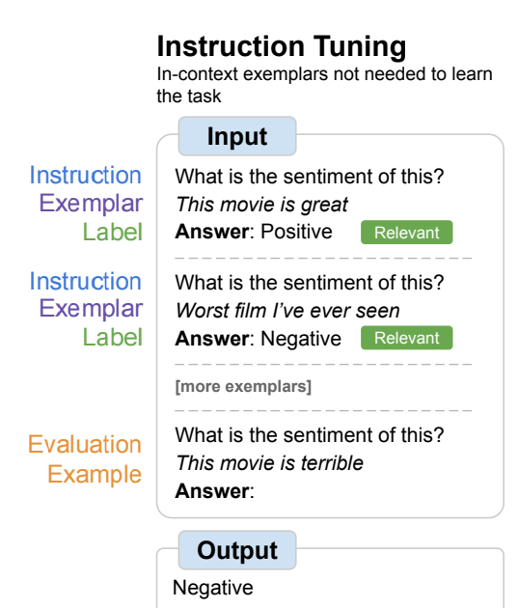
4. Instruction fine tuning
Instruction tuning is a form of supervised learning where the training data consists of instructions and we continue training the model on them using the same language modeling objective used to train the original model.
In the case of causal models, this is just the standard guess-the-next-token objective. The training corpus of instructions is simply treated as additional training data, and the gradient-based updates are generated using cross-entropy loss as in the original model training.
Notes:
Finetuning the values in WC requires supervised training data consisting of input sequences labeled with the appropriate sentiment class. Training proceeds in the usual way; cross-entropy loss between the softmax output and the correct answer is used to drive the learning that produces WC.
Note that can ba

Slide 42
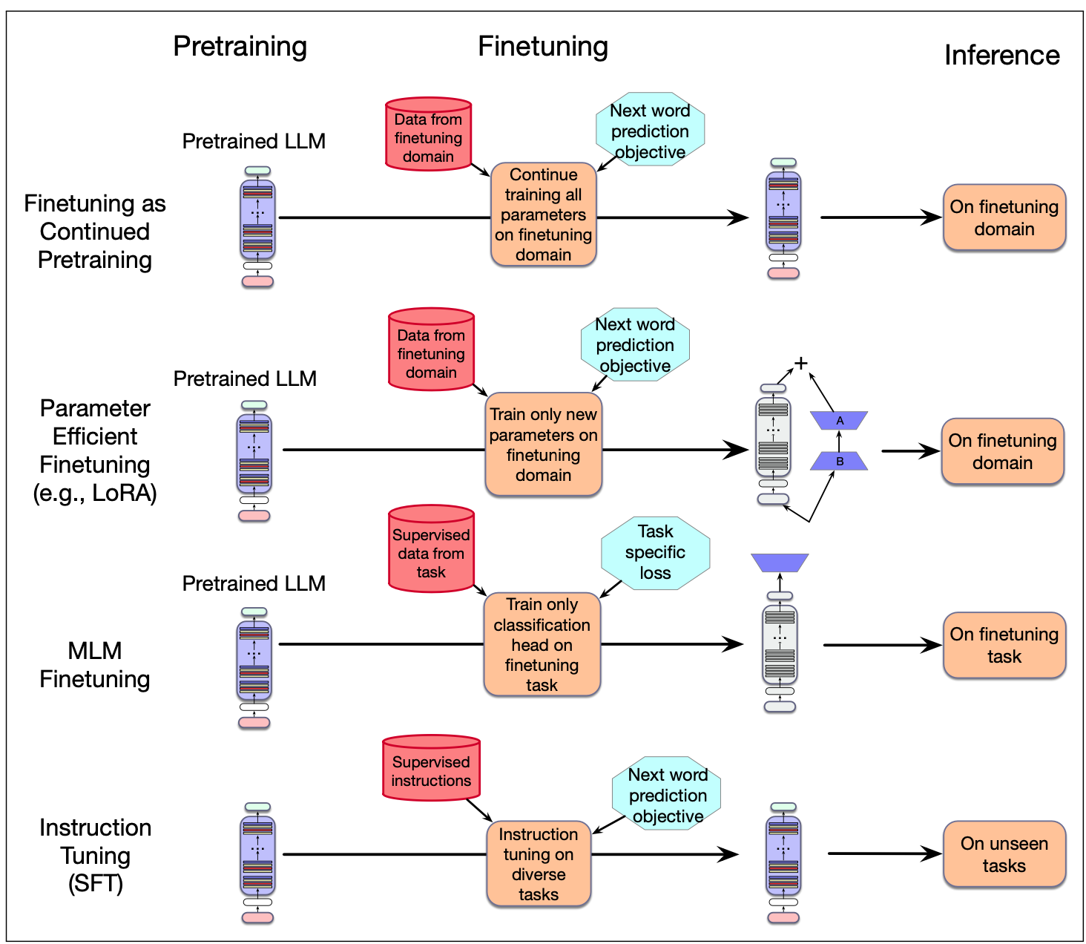

Slide 43
Large Language Models
Evaluating Large Language Models

Slide 44
Perplexity
Just as for n-gram grammars, we use perplexity to measure how well the LM predicts unseen text
The perplexity of a model θ on an unseen test set is the inverse probability that θ assigns to the test set, normalized by the test set length.
For a test set of n tokens w_{1:n} the perplexity is :

Slide 45
Why perplexity instead of raw probability of the test set?
Probability depends on size of test set
Probability gets smaller the longer the text
Better: a metric that is per-word, normalized by length
Perplexity is the inverse probability of the test set, normalized by the number of words
(The inverse comes from the original definition of perplexity from cross-entropy rate in information theory)
Probability range is [0,1], perplexity range is [1,∞]
Notes:
There's a problem with using probability. And that is that the probability of a test set depends very directly on the length of the test set. This is because probability gets smaller the longer the text. For n-gram models, this is very clear; the chain rule of probability means that for a test set of N words we are multiplying together N n-gram probabilities! It would be better to normalize the probabilities by length to get a metric that is per-word. Perplexity is just such a metric. Perplexity is the inverse probability of the test set, normalized by the number of words. We normalize by taking the N-th root of the probability of the test set.

Slide 46
Perplexity
The higher the probability of the word sequence, the lower the perplexity.
Thus the lower the perplexity of a model on the data, the better the model.
Minimizing perplexity is the same as maximizing probability
Also: perplexity is sensitive to length/tokenization so best used when comparing LMs that use the same tokenizer.

Slide 47
Many other factors that we evaluate, like:
Size
Big models take lots of GPUs and time to train, memory to store
Energy usage
Can measure kWh or kilograms of CO2 emitted
Fairness
Benchmarks measure gendered and racial stereotypes, or decreased performance for language from or about some groups.

Slide 48
Extra notebooks
https://github.com/RamiKrispin/ollama-poc/blob/main/ollama-poc.ipynb (intro to Ollama, for local LLM hosting)

